Slide 1
UltraMart | Sales Summary
File created on: 11/11/2020 7:52:03 PM

Slide 2
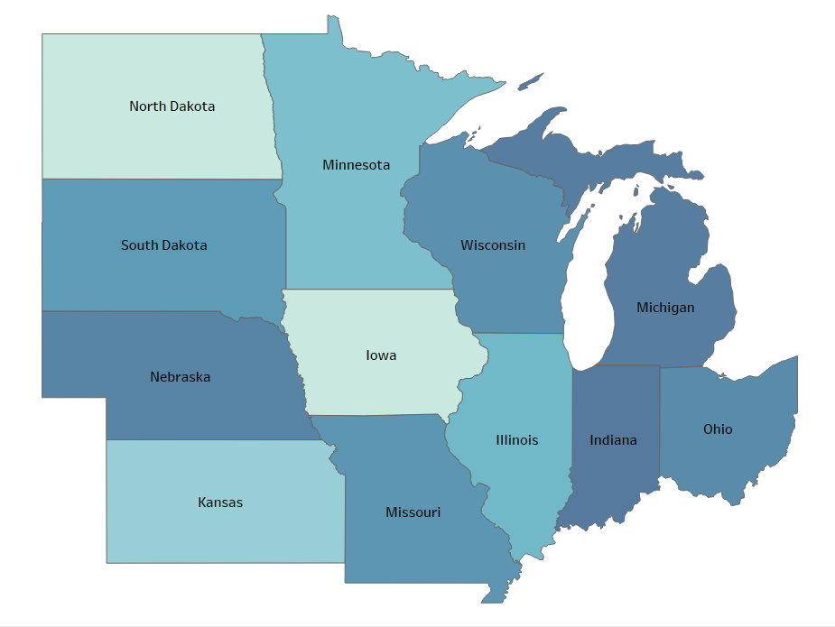
Overall performance indicators
Michigan, Indiana, and Nebraska are the highest performers with regards to Sales Per Square Foot

Slide 3
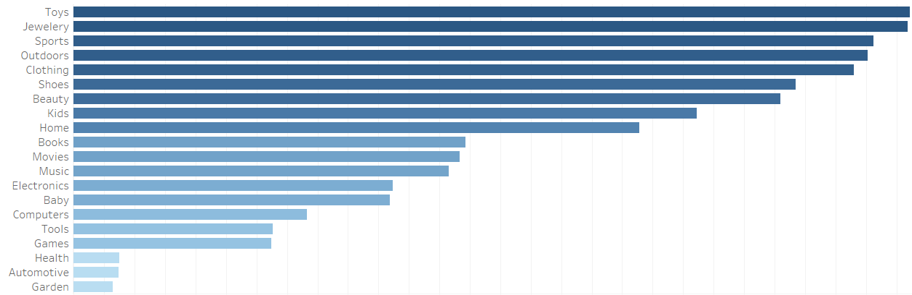
Sales per Department
Of all Departments toys, Jewelry, and sports out-perform other categories

Slide 4
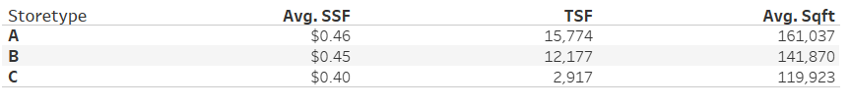
SSF Per Store Type
Store-type A generates the greatest average sales per square footage
Store-type A has the greatest average square footage and more transactions per square foot

Slide 5
Sales Per Square foot by state
Michigan’s B types perform the best
$0.54 Average SSF
2,968 Average Transactions per square foot
140,627 Average square footage per store

Slide 6
Best performing departments
The top three departments in Michigan are:
Toys (218 Transactions per square foot and $0.76 SSF)
Jewelry (232 Transactions per square foot and $0.81 SSF)
Clothing( 232 Transactions per square foot and $1.04 SSF)

